Slide 1
Welcome to Year 6
Monday 9th September 2024

Slide 2
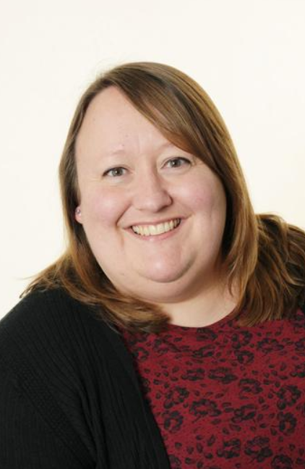
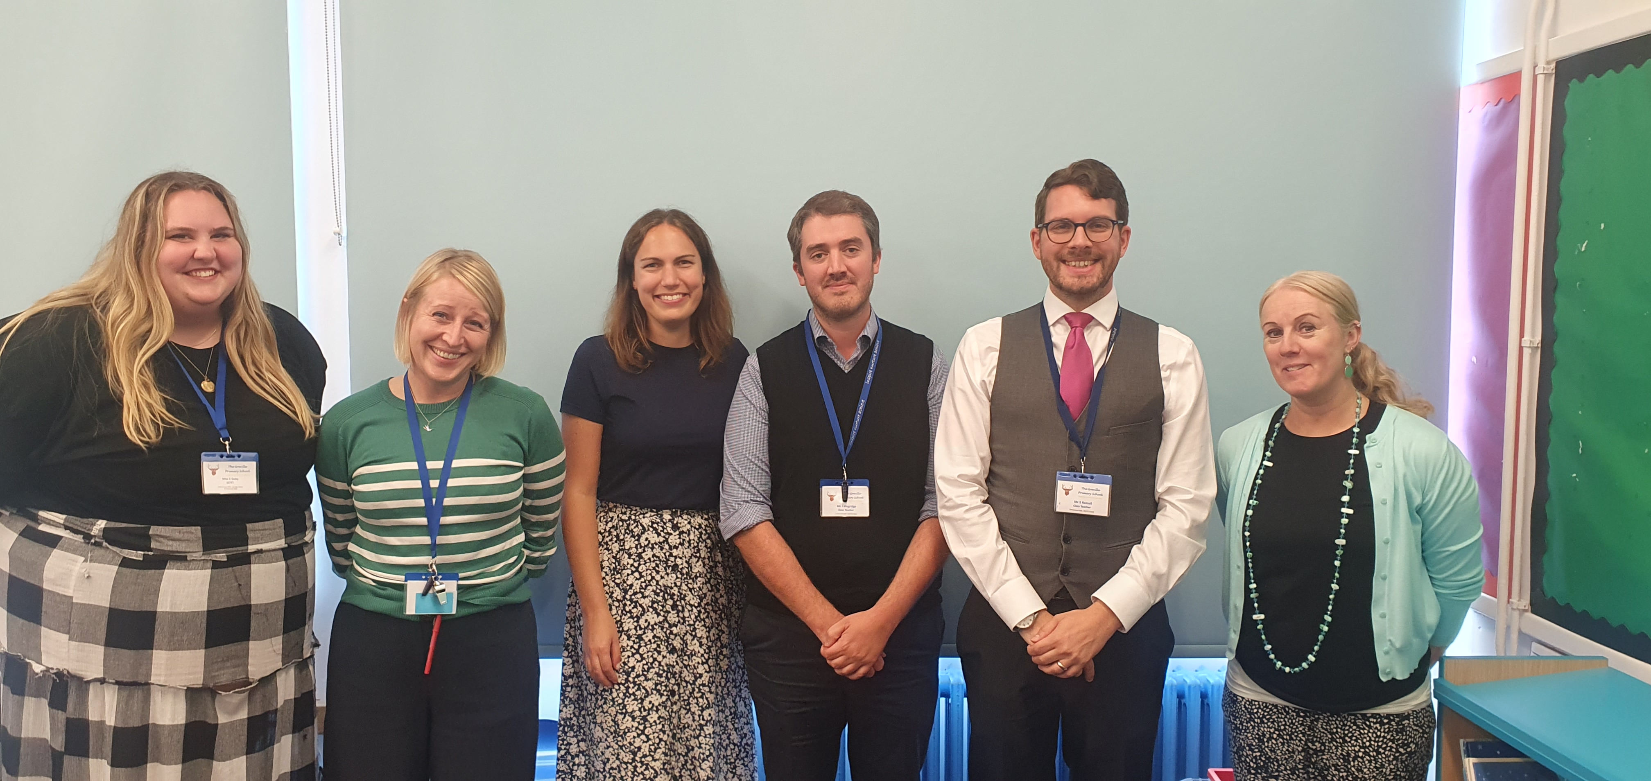
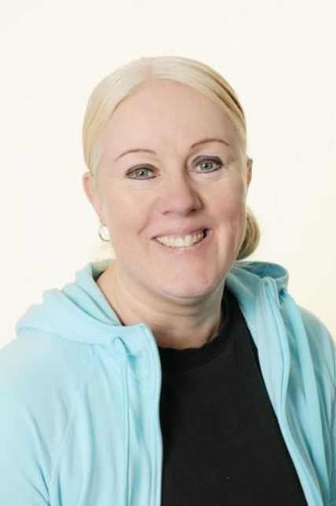
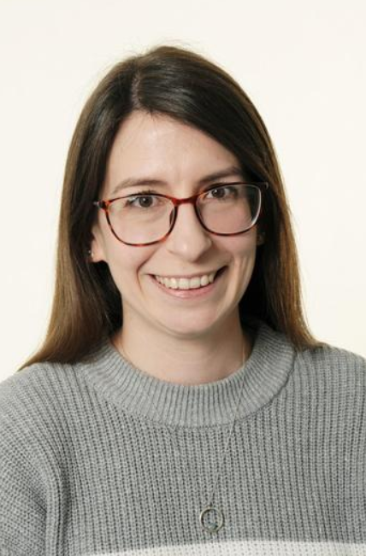
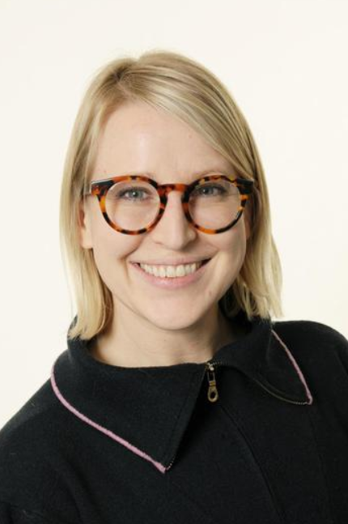
Year 6 teachers
Miss Simpson
Assistant Head & Year Group Leader
Mr Mogridge
6M
Mrs Porter
6P
Mr Razzell
6R
Miss Shamp
6SM
Miss Hall
Intervention teacher
Mrs Mead
Year 6 Leader and class teacher for 6SM from January

Slide 3
The School Day
08:30
12:30
School gates open, children, parents & carers allowed on the playground.
Gates will close at 8:55.
Lunch time
13:30
08:45
Afternoon lesson begin
Children welcomed into class to begin morning work
15:20
School gates open for parents/ carers to enter grounds ready for pick up
08:55
Registration finishes, day begins!
Come in through the office after 8:55.
15:25
11:00
Children let out from classrooms/ after school clubs begin
Playtime

Slide 4
Year 6 Expectations
Spellings and Times Tables:
Weekly spellings will be sent home in the children’s planner. These will be tested the following Monday.
Regular times table practice on TTRock Stars. There will be regular year group battles!
Reading:
We expect the children to read at home for 20 minutes at least 4 times a week. This should be recorded in their
planners. At least one of these reads should be with an adult.
Children have a weekly timetabled session in our junior library. There will be opportunities throughout the week for
children to complete quizzes for the books they have read on accelerated reader. This can be accessed from home as well.
Homework:
In Year 6, children will be set 3 short homework tasks a week: Maths on a Monday and Friday and English on a Wednesday.
All homework activities are designed to consolidate and practise previous learning and should take around 15 minutes to complete.
If your child really struggled with a task, or is taking much longer to complete a task, please reach out to their class teacher.

Slide 5

Key dates
PTA Outdoor Cinema – 14th September
Pupil Photographs– 30th Sep + 1st Oct
National Poetry Day – 3rd October
World Mental Health Day (Hello Yellow)
– 10th October
Harvest Festival - 17th October
PGL residential – 21st – 25th October
Parents evening – 19th & 21st November
Christmas carols – 10th December
Y6 Mayan Day – 28th February
SATs Week – w.b. 12th May
Bikeability – w.b. 23rd June and w.b. 7th July
Term Dates
October half term
28th Oct – 1st Nov
Christmas break
20th Dec – 6rd Jan
February half term
17th – 21st Feb
Easter
7th - 22nd April
May half term
26th -30th May
Summer break
22nd July

Slide 6
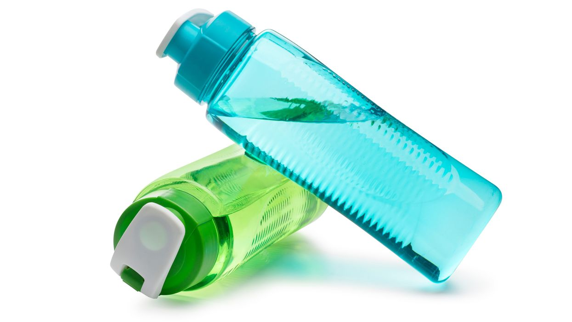
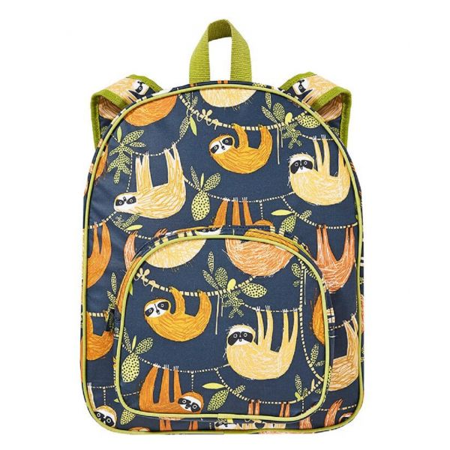
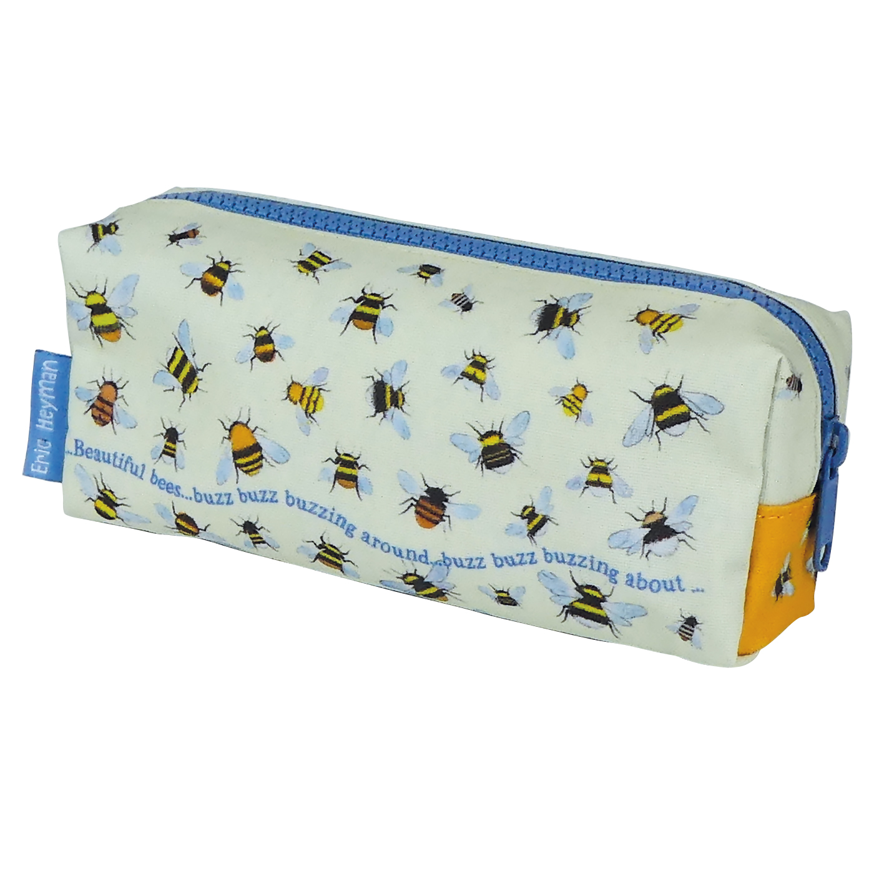
What to bring/ what not to bring
Named re-usable water bottle
Labelled school bag or book bag (not too big!)
While the school will provide children with all equipment they need such as pens, pencils, glue etc, your child may wish to bring in their own pencil case with items such as:
Colouring pens/pencils
Handwriting pen, pencil, whiteboard pen
Glue stick, ruler
Please ensure all items are labelled and pencil cases are not too big!
We would appreciate that any resources given by the teachers (pens etc) stay in school and do not go home.

Slide 7

Curriculum information
Curriculum Maps | The Greville Primary School
Subject Pages | The Greville Primary School

Slide 8
SATs Week Monday 12th – Thursday 15th May
Children will sit tests in:
Monday 12th – English Grammar, Punctuation and Spelling
Tuesday 13th – English Reading
Wednesday 14th – Maths Arithmetic + Reasoning
Thursday 15th – Maths Reasoning.
We do everything we can to ensure a balance between preparing the children and ensuring that they do not worry about the upcoming assessments.
We run SATs breakfast that week which children enjoy and sets them in the right frame of mind for the day.

Slide 9
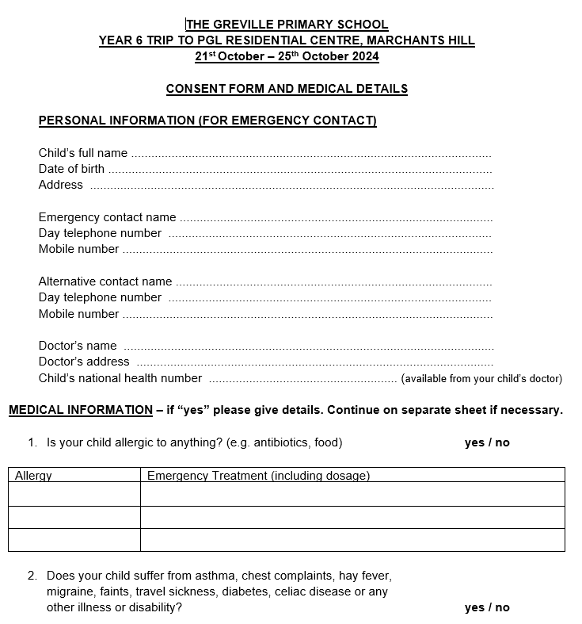



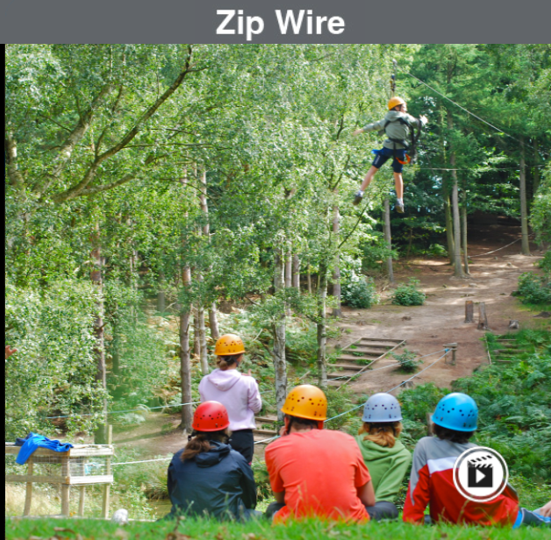
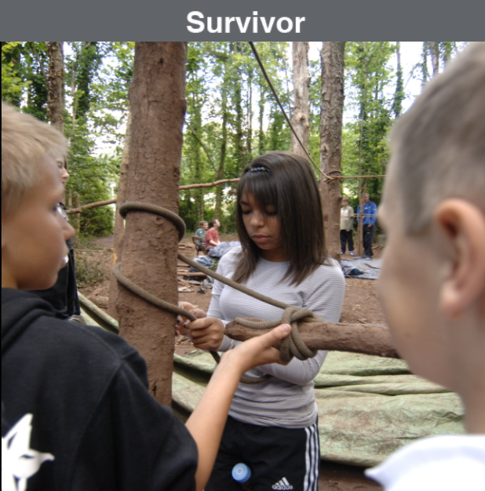
PGL 21st – 25th October 2024
Consent and medical forms have been sent out today. Please complete these carefully and return to your class teacher as soon as possible.
Those children not coming to PGL will have a fun week of activities planned with a known adult school.
We will be sending out more information over the next few weeks, which will hopefully answer all questions and be sharing the activities and relevant information with the children.
Activity Sneak Peek!
https://www.pgl.co.uk/Files/Templates/Designs/PGLCore/res/swf/virtual-tour/marchants/tour.html

Slide 10




A.O.B
Clubs
Fruit
Before school clubs begin at 8:00
Children in Years 3 and up are allowed to
Children can enter school using either
bring in a fruit snack for morning playtime.
the Infant or Junior gate.
Flapjacks are sold at a cost of 30p each
every Friday. These can be paid for in advance
After school clubs begin at 3:30 and
through wisepay.
run until 4:15 or 4:30. To safeguard the children
both gates will be locked. Children will be dismissed
Communication
By the club leader from the blue side gate
To arrange a meeting with your class teacher, email addresses are available on the school website. Please bear in mind that teachers will not be able to access their emails during the school day (any urgent information should go via the school office). Teachers will respond to emails within 48 hours. Please be considerate in your communication.
just inside the Junior entrance.
Please note: After a child signs up for a club, there is
an expectation that they go every week. If they will be absent
a message will need to be sent to the club leader or school office.

