Slide 1

`Working Together to Safeguard Children’ training for Greville Volunteers
Safeguarding children - the action we take to promote the welfare of children and protect them from harm.
Notes:
The Department for Education publishes Working Together to Safeguard Children 2018. The current guidance was updated on the 1st July 2022. The host page for the guidance says:
This is a factual update to Working Together to Safeguard Children 2018 to reflect recent changes to legislation, including:
Integrated Care Boards: from 1 July 2022, integrated care boards have replaced clinical commissioning groups as a result of the Health and Care Act 2022;
Public Health England: has now been replaced by the UK Health Security Agency and the Office for Health Improvement and Disparities (OHID), which is part of the Department of Health and Social Care, and by the UK Health Security Agency. The Chief Public Health Nurse role has transferred to OHID;
Domestic Abuse Act 2021: references to the Domestic Abuse Bill should be read as the Domestic Abuse Act 2021;
UK GDPR: references to the GDPR should be read as the UK GDPR. The UK GDPR is the retained EU law version of the GDPR. The UK GDPR sits alongside the Data Protection Act 2018.
Note: there have been no changes to the current document which still contains the old terminology.
Keeping Children Safe in Education published September 2023, should be read alongside Working Together to Safeguard Children.

Slide 2
Aims
To recognise concerns about the safety and welfare of children
To understand what to do if a volunteer has a safeguarding concern

Slide 3
Who are the Greville’s Designated Safeguarding Leads (DSLs) 2024-25?
Duncan Steele (lead)
Deputies..
Louise Hammond
Millie Cushnie
Louise Simpson
Alex Williams
Emma Bennett
Victoria Goram
dsl@greville.surrey.sch.uk (generic email)
(FYI- Mrs Tisi has left)

Slide 4
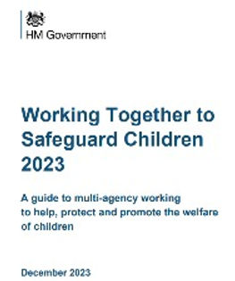
Working Together to Safeguard Children 2023
“Everyone who works with children has a responsibility for keeping them safe. No single practitioner can have a full picture of a child’s needs and circumstances and, if children and families are to receive the right help at the right time, everyone who comes into contact with them has a role to play in identifying concerns, sharing information and taking prompt action.”
Notes:
This is the ‘umbrella’ guidance for safeguarding and child protection

Slide 5

What is abuse and neglect?
A form of maltreatment of a child.
Somebody may abuse or neglect a child by inflicting harm or failing to act to prevent harm.
Children may be abused/neglected:
  In a family
  In a community setting
  In an institution
  By a stranger
  Online
  By another child or children or peer on peer (unhealthy relationships)

Slide 6
What are the categories of abuse?
Physical Abuse - is deliberately physically hurting a child.
Emotional Abuse (including Domestic Abuse) - Persistent emotional maltreatment
of a child such as to cause effects on the child’s emotional development. Sometimes
called psychological abuse. It may involve serious bullying- including online bullying
through social networks, online games or mobile phones- by a child’s peers.
Neglect – persistently failing to provide for a child's basic needs, whether it be
adequate food, clothing, hygiene, supervision or shelter. It is likely to result in
serious impairment of a child’s health or development.
Sexual Abuse and Child Sexual Exploitation (CSE) – any sexual activity with a
child. Sexual exploitation involves an exchange of some sort. Many children and
Young people who are victims do not recognise themselves as such.
(WTSC 2023)

Slide 7
Signs that may indicate a child is experiencing abuse or neglect
Excessive hunger
Poor personal hygiene
Frequent tiredness
Inadequate clothing
Frequent lateness or non-attendance at school
Untreated medical problems
Poor relationships with peers
Compulsive stealing or scavenging
Rocking, hair twisting or thumb sucking
Running away
Loss of weight, or being constantly underweight (same applies to weight gain or being excessively overweight)
Low self esteem
Poor dental hygiene
Association with controlling/older individuals/peers
Sudden speech disorders
Self-harming (including eating disorders)
Drug, alcohol and solvent misuse
Lack of empathy (including cruelty to animals)
Concerning interactions between parent/carer and the child (e.g. excessive criticism of the child or lack of boundaries)
Changes in behavior/ language
Changes in social interaction
Changes in physical wellbeing
Carrying weapons
Decline in school performance
Unexplained injuries
Unexplained acquisition of money, clothes or mobile phones
Gang association
Notes:
Think about using professional curiosity to determine whether something feels wrong.

Slide 8
Sexual Violence and Sexual Harassment between Children in Settings
Sexual violence and sexual abuse can happen anywhere, ‘it can happen here’.
Adults are required to respond appropriately to all reports and concerns, including those outside the school, and or online.
Settings must have a zero-tolerance approach to sexual violence and sexual harassment, and it is never acceptable, and it will not be tolerated, and it should never be passed off as “banter”, “just having a laugh”, “part of growing up” or “boys being boys”

Slide 9
Which children are more vulnerable to abuse or neglect and why?
Children may be more vulnerable to being harmed if they are:
Unborn
Babies
Disabled children and those with Special Educational Needs (SEND)
Children who are perceived as being different
Children who are already thought of as a problem by professionals
Children who are Looked After or returned home from care
Children in secure and residential settings
Young carers
Older children including those engaging in antisocial or criminal activity
LGBTQ+
Notes:
Please note children subject to a Special Guardianship Order (SGO) or placed with family and friends (Connected Person) will also be vulnerable children

Slide 10
What barriers do you think might get in the way of you or others taking action to protect children?
What if I’m wrong?
I could make things worse
Fear of repercussions
Not my job
I don’t know what to do
What do I know?
I could jeopardise my relationship with the family
I’m new in my role, I don’t want to make a bad impression
No one will listen to me
Disbelief
Losing sight of the child
Mindsets – ‘It doesn’t happen here’, ‘It couldn’t happen in that family’
Unclear about roles/responsibilities
Failure to seek appropriate advice/support
Making assumptions
Professional optimism
Unconscious bias

Slide 11
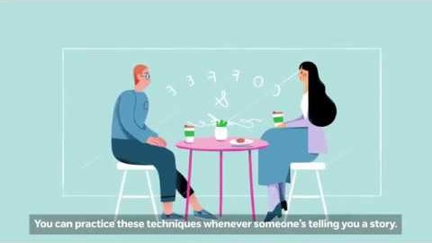
Responding to a Safeguarding concern
Notes:
Responding to a Child's Disclosure of Abuse | NSPCC Learning - YouTube

Slide 12
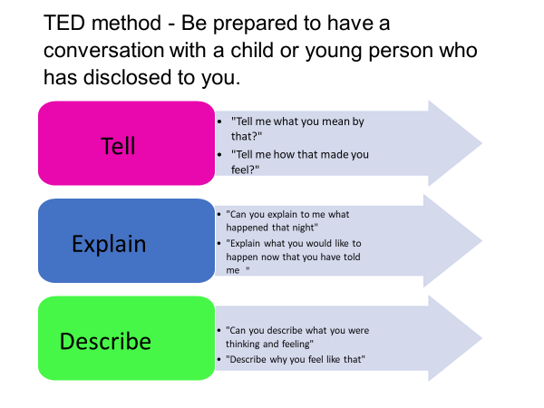
What to do if a child discloses
Listen
Reassure
Provide support
Explain what will happen next
Take it seriously
Record the conversation in the child’s words
Make sure you capture all the required information.
Sign and date the recording
Do not investigate or ask leading questions.
Speak with the class teacher or a DSL as soon as possible
Notes:
You may become aware of concerns via other means
a. Stay calm and listen carefully.
b. Reassure them that they have done the right thing in telling you.
c. Do not investigate or ask leading questions. The questions staff are
advised to use are the TED questions
1. Tell me what happened‟
2. Explain or
3. Describe
d. Let them know that you will need to tell someone else.
e. Do not promise to keep what they have told you a secret.
f. Inform your Senior Designated Officer as soon as possible.
g. Make a written record of the allegation in the child‟s own words,
disclosure or incident which you must sign, time, date and record your
position using the school's safeguarding record log forms at the
earliest possible time after the disclosure being made. Do not wait to
finish the session as this is part of evidence recording. If you are
concerned that a member of staff or adult in a position of trust
poses a danger to a child or young person, or that they might be
abusing a child or young person, you should report your concerns to
the Head. Where those concerns relate to the Head
however, this should be reported to the Chair of Governors using the
schools „Whistle blowing‟ policy.

Slide 13
Don’t…..
Make promises that you cannot keep
Ask leading questions
Jump to conclusions
Speculate or make accusations
Display any disbelief
Delay in responding immediately to protect a child
Act shocked or disgusted
It is not your responsibility to decide if the allegation is true or not
Notes:
Four possibilities for telling
Hidden - actively avoids telling, hides and denies
Signs and symptoms - shows through behaviour and presentation so brought to attention of services, though not directly disclose or intend to disclose
Prompted telling - after displaying symptoms builds trust in professional and discloses
Purposeful telling - purposefully approaches someone to tell

Slide 14
What happens after a concern is raised at The Greville ?
The concern will be passed on to the class teacher or a DSL and this will be followed up as soon as possible with the child.
The DSLs will decide what action needs to happen. For example a discussion with a parents, a phone call to children's services to get more advice or just monitor the child.
All concerns and actions are logged on our safeguarding system called CPOMs.

Slide 15
Managing Allegations Against Staff
If you have a concern about an adult’s conduct in the school, speak with one of the DSLs.
The lead DSL will be notified and can get advice from the LADO (Local Authority Designated Officer) Service which manages allegations against individuals who work or volunteer with children in Surrey.
or LADO@surreycc.gov.uk.
If the concern is about the headteacher, contact the chair of governors, Trevor Hood.
THood@greville.surrey.sch.uk
Notes:
Be aware of safer recruitment policies and practice.

