Slide 1

Welcome to our session
Understanding SEN Support at The Greville Primary School
Donna Hardcastle
SEN Support Advisor
Team Around the School Support Hub
Notes:
Introduce ourselves and team

Slide 2







What we will cover today
What are Special Educational Needs (Additional Needs)
How schools support additional needs
Your school's Graduated Response
National statutory process for education, health & care needs
Answer your questions
Notes:
Unerstand what is meant by Special Educational Needs (Additional Needs)
Explain how schools support children with Additional Needs by using the Graduated Response
Be aware of your school’s offer for Additional Needs
Outline the national statutory process for deciding if a child requires an Education, Health and Care Plan
Answer any questions you may have regarding additional needs

Slide 3
What does Special Educational Needs (SEND) mean?
“A child or young person has SEN if they have a learning difficulty or disability which calls for special educational provision to be made for him or her.”​
Children and Family Act 2004- Section 20
SEND Code of Practice 2014

Slide 4


Graduated Response to
Special Educational Needs
Graduated Response
Ordinarily Available Provision
Notes:
Do you know what high quality teaching means?
HQT considers the needs of learners which then informs planning and delivery to make learning accessible. (Comes from the OAP document – SCC
High Quality Teaching-
Adaptive teaching
Responsive to need
Meets the need of majority of learners
Bread and Butter of teaching
This could be- Visual timetable, scaffolding built into lessons, prompts
All strategies that are ordinarily available to mainstream settings- refer to booklets
Linking it to the SEND CoP- “High quality teaching, differentiated for individual pupils, is the first step in responding to pupils who have or may have SEN. Additional intervention and support cannot compensate for a lack of good quality teaching.”
SEND Support
Needs not being met by HQT- school will implement OAP strategies as outlined on the Local offer- Can be used as a checklist
Grouped in the 4 areas of need- cognition and learning, communication and interaction, SEMH and physical and sensory
“Where a pupil is identified as having SEN, schools should take action to remove barriers to learning and put effective special educational provision in place. This SEN support should take the form of a four-part cycle.”
Every school’s OAP will be adapted to their context e.g. some schools may have a sensory room due to high levels of need but others may not
Assess plan do review – small step SMART targets
SEND Register
Additional Support- Schools may involve specialists at any point to advise them on early identification of SEN and effective support and interventions.
“…A school should always involve a specialist where a pupil continues to make little or no progress or where they continue to work at levels substantially below those expected of pupils of a similar age despite evidence-based SEN support delivered by appropriately trained staff...” SEND CoP
The pupil’s parents should always be involved in any decision to involve specialists.”
Additional Support
School make referrals to outside agencies
Forms part of Graduated response
Targets updated on professionals advice
Parental consent will be required for this

Slide 5

“High quality teaching, differentiated for individual pupils, is the first step in responding to pupils who have or may have SEN. Additional intervention and support cannot compensate for a lack of good quality teaching.”
SEND Code of Practice 2014 6.37
Notes:
Do you know what high quality teaching means?
HQT considers the needs of learners which then informs planning and delivery to make learning accessible. (Comes from the OAP document – SCC
High Quality Teaching-
Adaptive teaching
Responsive to need
Meets the need of majority of learners
Bread and Butter of teaching
This could be- Visual timetable, scaffolding built into lessons, prompts

Slide 6
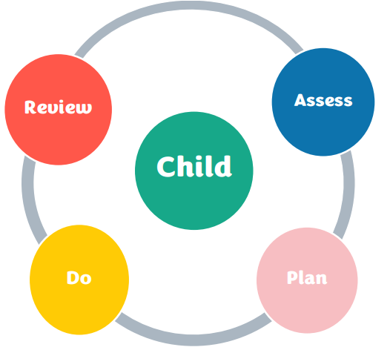
“Where a pupil is identified as having SEN, schools should take action to remove barriers to learning and put effective special educational provision in place. This SEN support should take the form of a four-part cycle.”
SEND Code of Practice 2014 6.44
Notes:
All strategies that are ordinarily available to mainstream settings- refer to booklets
SEND Support
Needs not being met by HQT- school will implement OAP strategies as outlined on the Local offer
Grouped in the 4 areas of need- cognition and learning, communication and interaction, SEMH and physical and sensory
Can be used as a checklist
Every school’s OAP will be adapted to their context e.g. some schools may have a sensory room due to high levels of need but others may not
Assess plan do review – small step SMART targets
SEND Register

Slide 7
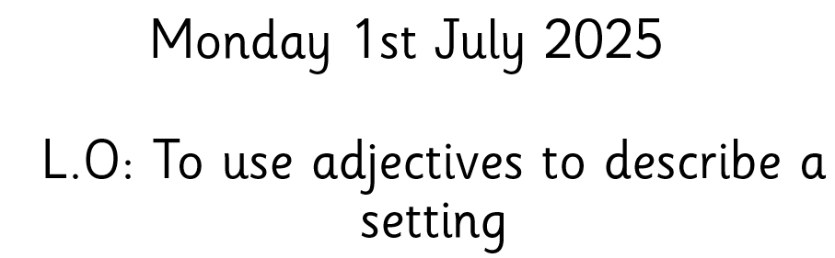

Notes:
The lesson is part of a carefully planned sequence of lessons where the children are learning about descriptive writing. Having a planned sequence of lessons which will help children to move on from their starting point and hopefully reach the end of year objectives is part of HQT.
Imagine- the teacher has started the lesson by taking the children outside to look at the playground area getting them to describe what they are seeing.

Slide 8
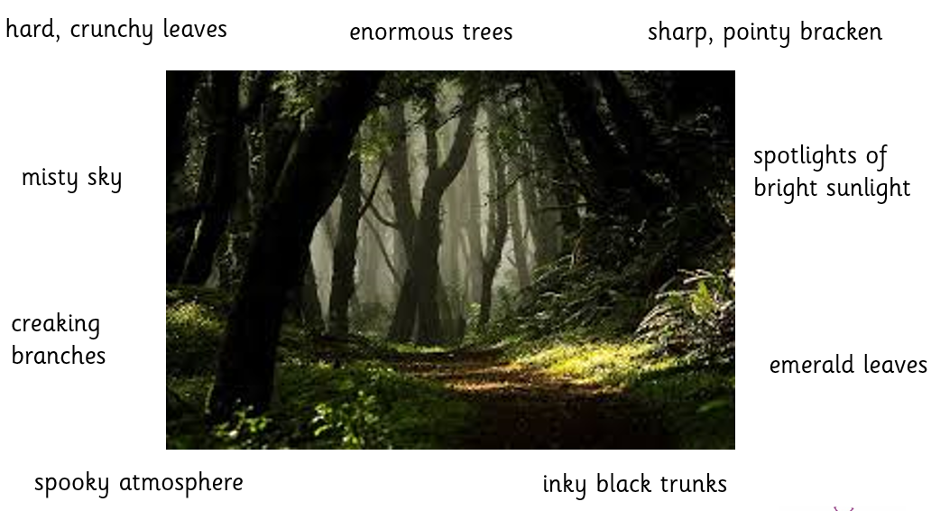
Notes:
Teacher shares a picture on the board- asks in pairs for children to share their ideas of what they can see before receiving feedback and writing them around the picture. Teacher is correcting any misunderstandings e.g. if the words are not adjectives

Slide 9
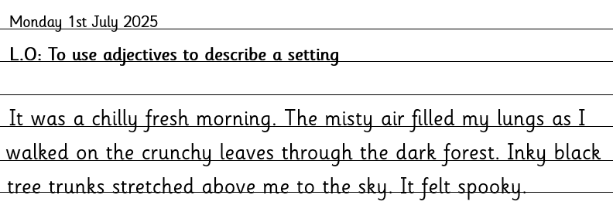
Notes:
The teacher has then done a shared piece of writing with the class so the children have a model of what they need to do. Providing a model and modelling the process of getting there is part of high quality teaching.

Slide 10









Notes:
The teacher makes sure that the children understand what adjectives are, the children work in pairs to identify them in the shared piece of writing. The teacher then gives the instruction to go back to their tables, write the date, LO and at least 4 sentences to describe the forest. She tells them to start on a clean page, leave a space between the date and their writing.
After a while the teacher notices that Paul hasn’t got started. He looks a bit anxious. She asks him if he knows what to do, he says yes. Just in case she repeats the instructions: write the date, LO and at least 4 sentences to describe the forest. She tells them to start on a clean page, leave a space between the date and their writing.
After another 5 minutes the TA comes and sits by Paul who is still sitting with an empty page. She sees he hasn’t written the date so she points out where it is on the board and asks him to copy it down. A few minutes later, the teacher asks if anyone needs help. Paul doesn’t put his hand up.
What’s going on for Paul?
5 minutes later the teacher comes over to Paul, who still has a blank page. She asks him again if he knows what to do – but he just gets up and shouts, I’M NOT DOING IT! And goes to sit in the book corner.
The teacher is confused, she’s provided a visit, a multi-sensory learning experience, modelled what to do, left the model on the board and he still hasn’t done his work.

Slide 11

Communication and Interaction
Strengths:
Paul is friendly and polite
Needs:
Paul finds it difficult to understand a lot of language or instructions given at once
Paul finds it hard to speak in full sentences
Cognition and Learning
Strengths:
Paul is a strong reader
Paul loves stories
Needs:
Paul finds it hard to compose and record his work
Social, Emotional and Mental Health
Strengths:
Paul has lots of good friendships
Needs:
Paul can struggle to say how he feels
Paul can struggle to regulate his emotions
Sensory and Physical
Strengths:
Paul is a great swimmer
Needs:
Paul finds handwriting difficult and tiring
Paul finds it hard to sit still in class
Paul struggles to copy from the board
Paul
Notes:
After school later that week, the teacher meets with Paul’s parents and the SENCo. They draw up this profile about Paul. For the next lesson the teacher and the SENCo agree some adaptions and provision which they hope will help Paul to show his learning without so many difficulties.

Slide 12



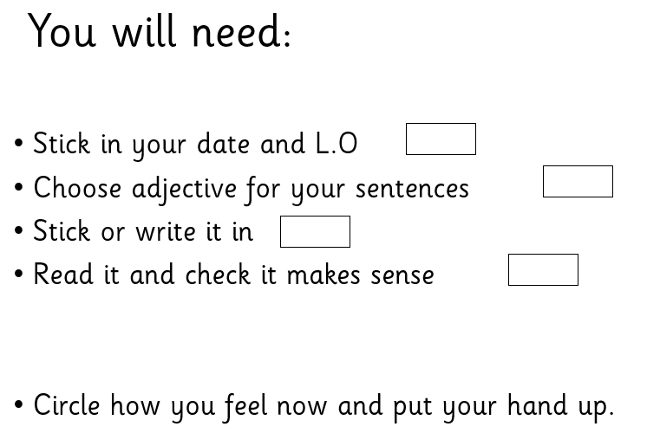
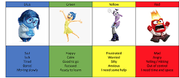
Task planner
Notes:
The teacher produces a task board so that Paul doesn’t have to remember all the instructions that were said verbally. Paul is a good reader, otherwise this perhaps would be given more visually.
To give him a movement break as he doesn’t like sitting, she wants him to get up and collect his equipment
She gives him some options of writing or sticking. He doesn’t have to write more than he needs to do show his understanding.
She gives him a chance to work on his emotions language and she will judge at this point whether he can have a go writing another sentence on his own or not.

Slide 13
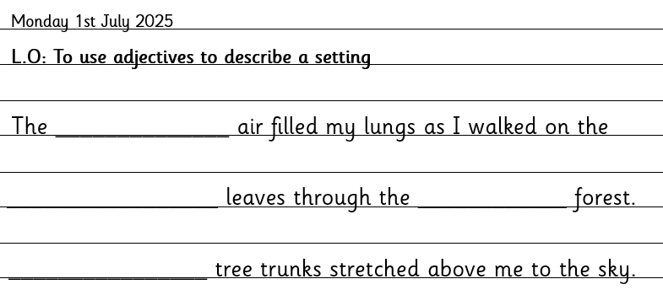
Example
cold warm misty
crunchy orange dead crisp
spooky dark cloudy bright
Notes:
She’s provided the date and L.O which he can cut and stick rather than copying from the board, which he finds difficult. His learning is focused around the learning objective – using adjectives – and is from a starting point that Paul can manage. The teacher plans to get the TA to do some extra handwriting practice with Paul in a small group she is running. The teacher and SENCo have begun to ASSESS his needs, PLAN his provision and they will now DO this and this will enable them to REVIEW how he gets on. Of course this is very simplified and they may need to access some specialists to assess his language difficulties, or this may be enough.

Slide 14
Linking it all together…
Task board
Scaffolds – writing frame, key vocabulary
Adapted equipment
Planned sequence of lessons
Multi-sensory learning
Modelling
Visuals
Group & paired discussion
Notes:
Hopefully this very simplified example gives you an idea of all of the things that can form part of HQT, some ordinarily available provision at SEN support and how the assess, plan, do, review process can work. Every school is different, which is why I will now handover to the Grove to explain how it looks here.

Slide 15
What the Graduated Response looks like at The Greville Primary School

Slide 16
What the Graduated Response looks like at The Greville Primary School

Slide 17
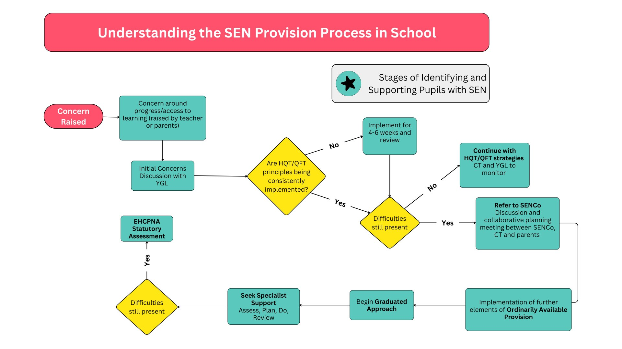

Slide 18

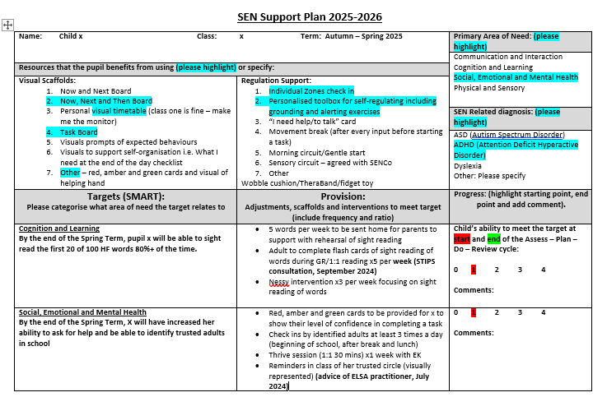
For all children on the SEN Register
(have a need that requires above and beyond HQT)
These cycles of support serve as evidence towards an EHCP (where necessary)
Updated termly. Parents contribute ideas at Parents’ Evenings

Slide 19
Examples of Support for 4 areas of Need at The Greville
Communication and Interaction | Cognition and Learning | Social, Emotional and Mental Health | Physical and Sensory
Small group or 1:1 support on S&L targets | Memory aids – Task Board | Social stories and comic strip conversations | Sensory aids e.g. chewies, wobble cushion, ear defenders
Social skills groups e.g. Lego Therapy | Personalised teaching approaches e.g. TEACCH | Social skills group e.g. Role Play | Sensory circuits
Attention Autism to develop listening and attention skills | Targeted interventions – Precision Teaching | ELSA or Thrive | Movement breaks
 | Reading Interventions | Higher ratio adult support at break/lunch | Adaptations to environment /designated space
 | Tailored spellings

Slide 20
How does the EHCP process work?
Notes:
Jill
EHCP
Exhausted the previous steps
Formal assessment of needs and has been agreed there needs to be a legal document
School have to identify that they have been through all of the other steps
Jan 2024- 4.8% had EHCP Nationally
Jan 2024- Surrey had 5.2% EHCP
Children do not need an diagnosis for an EHCNA
Most children with an EHCP go to mainstream schools

Slide 21
The National Statutory Process – 20 weeks
The EHC Needs Assessment is Requested
By 16 Weeks
The LA must finish the assessment and tell you if they think your child needs and EHC plan.
By 20 Weeks
The LA must complete the final draft of your child’s EHC Plan
By 6 Weeks
The LA must tell you if they will or will not be assessing your child.
Between 16-20 Weeks
The LA will send you a draft EHC plan. You have 15 days to comment and request a specific school.
Notes:
Requesting an Education, Health and Care needs assessment 6.63 SEN support should be adapted or replaced depending on how effective it has been in achieving the agreed outcomes. Where, despite the school having taken relevant and purposeful action to identify, assess and meet the SEN of the child or young person, the child or young person has not made expected progress, the school or parents should consider requesting an Education, Health and Care needs 104 assessment (see Chapter 9). To inform its decision the local authority will expect to see evidence of the action taken by the school as part of SEN support.
•Before EHCP is granted- submit application to L-SPA team- most effective applications show collaboration between home school and YP
•By 6 weeks- panel read cases and agree yes/no to assess- if no to assess, recommendations given
•If yes to assess- passes to quadrant SEND team and assessment begins- always have an EP assessment
•By the end of week 16- the assessment info has gone to governance board who read all the evidence and agree whether it is a yes or no to issue.
•If a no to issue- school and family still receive all the information gathered in the assessment process and a summary that they can then use
•Parents have a right to mediation and appeal
•If yes to issue by the end of week 20- you will receive a draft EHCP to review and so will educational settings
•Once finalised- EHCP names the educational setting and every 12 months the targets and information is reviewed
•This is a joint process between school and family and YP

Slide 22


True or False
True or False?
Notes:
Jill and Rachel

Slide 23
Some Useful Links…
Surrey Local Offer
Provision by SEN that schools could offer
SEND Advice Surrey
SEN guide for parents and carers
Top 10 tips for families
Notes:
Jill

Slide 24


Questions

