Slide 1
Welcome to Year 2
16th September 2024

Slide 2
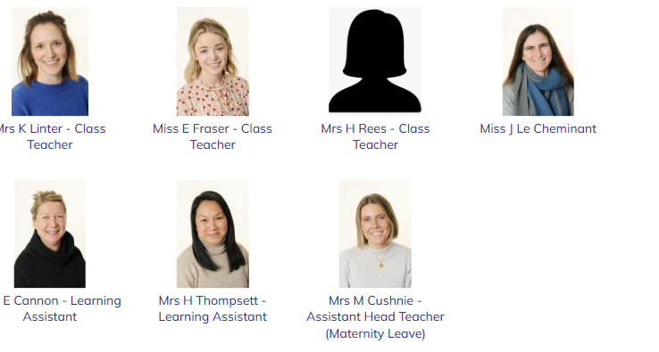
Year 2 teachers
Mrs Linter
KS1 and Early Maths Lead
Miss Fraser
Early writing lead
Mrs Cushnie
Assistant Head
Mrs Thompsett Mrs LeCheminant Mrs Cannon
Mrs Linter’s email:
klinter@greville.surrey.sch.uk
Miss Fraser’s email:
efraser@greville.surrey.sch.uk

Slide 3
The School Day
08:30
12:00
School gates open, children, parents & carers allowed on the playground.
Gates will close at 8:55.
Lunch time
13:00
08:45
Afternoon lesson begin
Children welcomed into class to begin morning work
15:20
School gates open for parents/ carers to enter grounds ready for pick up
08:55
Registration, day begins!
15:25
10:30
Children let out from classrooms/ after school clubs begin
Playtime

Slide 4
Year 2 expectations
Homework:
Weekly spellings will be sent home in the children’s planner. These will be tested the following Monday.
Weekly maths homework will be on Numbots - log in details will be in your child’s planner.
Reading:
We expect the children to read at home to an adult at least 4 times a week. This should be recorded and signed in
their planners.
Your child will take home two books each evening, a Read Write Inc book which is directly linked to their current
reading level and another book that they can choose from our Infant selection. Although the second book is not
linked to their exact reading level, your child will still be able to use their phonic knowledge to decode and read the
majority of the book, whilst expanding their exposure to different texts.
Books will be changed every Friday and reading will be checked on a Monday.

Slide 5
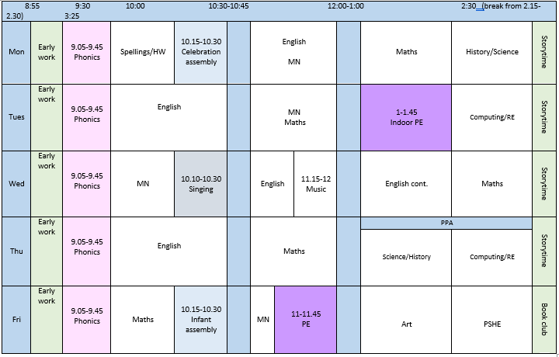
Time table
Things to remember!
-Dragonflies:
PE & Games on Tues & Fri
-Ladybirds:
PE & Games on Mon & Wed
- Gates close at 8:55!

Slide 6
Key year group information
Key Stage 1 assessments
SATs are no longer a compulsory end of key stage assessment. Instead teachers
will be using their own judgement based on the children’s learning throughout the year and end of unit
quizzes to determine whether they leave Year 2 as Working Towards, Expected or Working at Greater Depth.
As a school, we have decided that we will still administer the tests but these will only be used to go towards
our own judgements on the children.
The Phonics Check
For those children that didn’t meet the pass mark for the Phonics Check this year, they will receive additional
support throughout the year and sit the check again next June.

Slide 7

Key dates
Pupil Photographs– 29th and 30th Sept
Harvest Festival - 9th October
Parents evening – 18th & 20st November
Christmas Carol Service – 17th Dec
Infant show – 8th/9th/10th Dec
Windsor Castle trip – 6th March
Term Dates
October half term
23rd Oct – 31st Oct
Christmas break
22nd Dec – 6th Jan
February half term
16th – 20th Feb
Easter
30th Mar – 14th April
May half term
25th -29th May
Summer break
22nd July

Slide 8
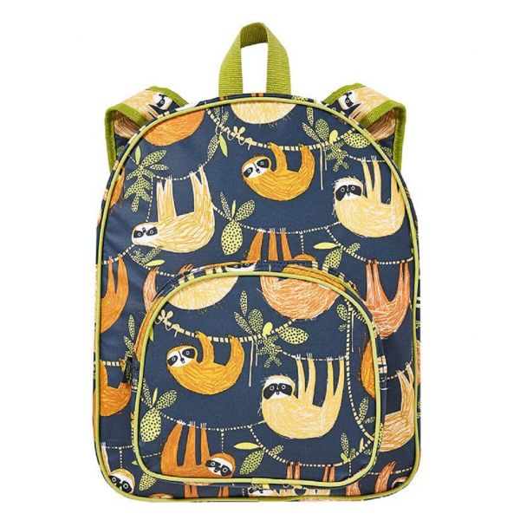
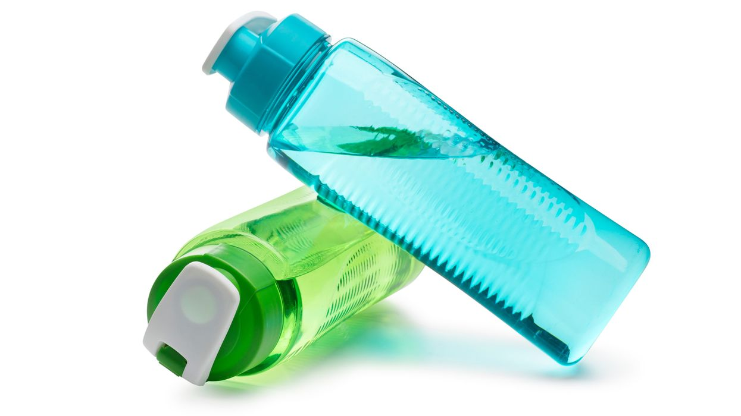
What to bring/ what not to bring
Named re-usable water bottle
Labelled school bag or book bag (not too big!)
Reading books and reading record
Your child will not need a pencil case with pencils, glue stick etc. school will provide all of this.
Please do not allow your child to bring in toys or football cards.

Slide 9
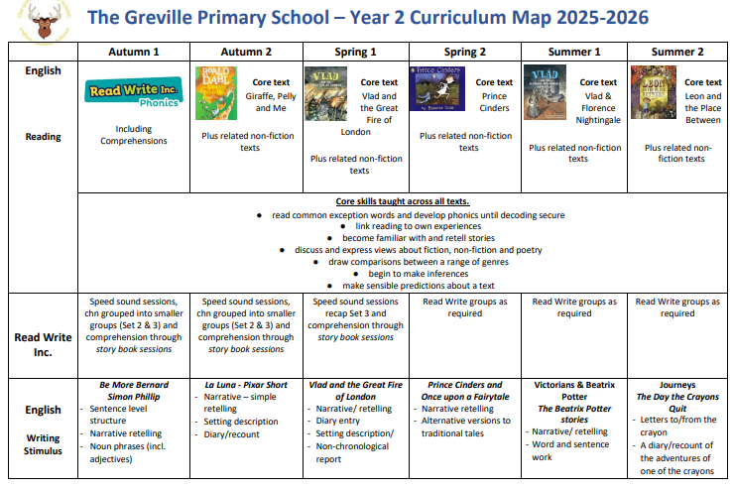
Curriculum information
Curriculum Maps | The Greville Primary School
Subject Pages | The Greville Primary School

Slide 10




A.O.B
Clubs
Fruit
Please ensure you sign up your child through the links sent by the office. Please not whether it is a lunch time or after school club.
The provided fruit snack will be
available to children each morning break.
Line of communication
Please note: After a child signs up for a club, there is
klinter@greville.surrey.sch.co.uk
an expectation that they go every week.
efraser@greville.surrey.sch.co.uk
Uniform
Please ensure your child is in the correct uniform and that it is named!
On a PE day, please remove any earrings and ensure trainers are suitable for PE.

