Slide 1

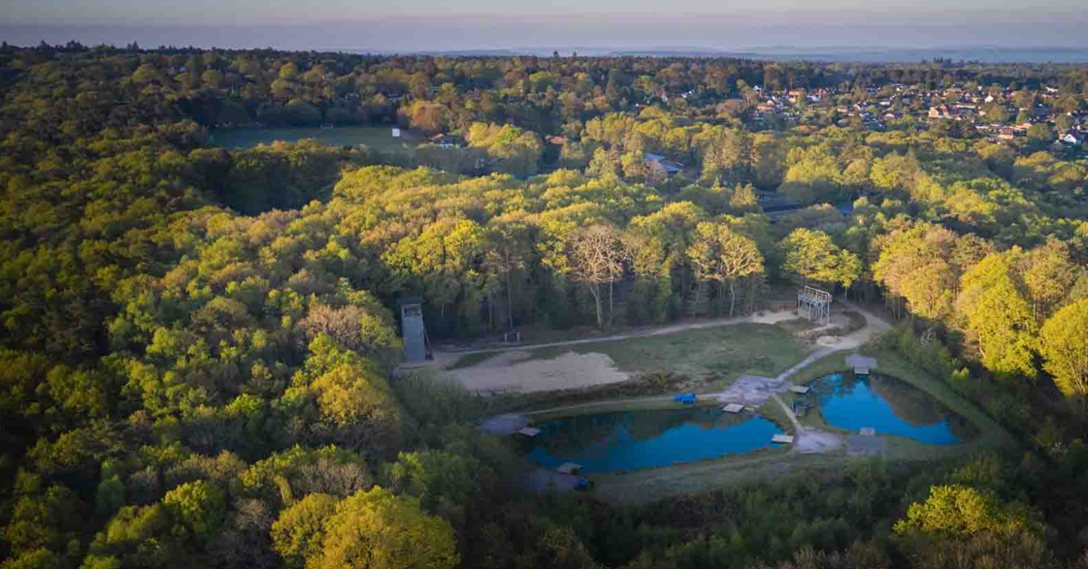
13th – 17th October 2025
Marchants Hill
Surrey

Slide 2

Why PGL/Residential?
Builds Independence
Year 6 right of passage!
Team Building

Slide 3
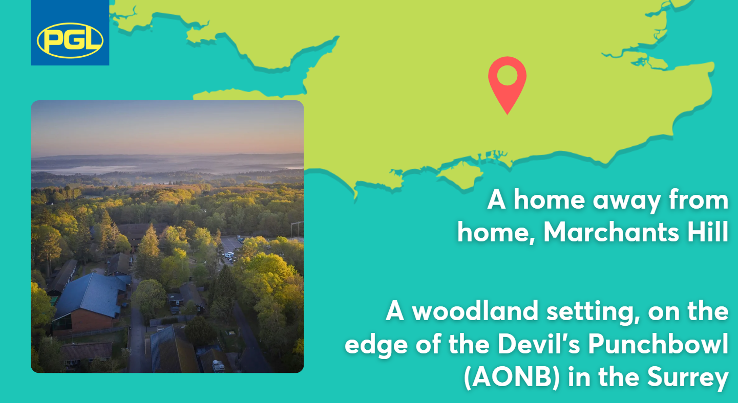
Where we’re going…
https://www.pgl.co.uk/Files/Templates/Designs/PGLCore/res/swf/virtual-tour/marchants/tour.html
https://www.canva.com/design/DAFZbzx6IAo/WG08uCfvsKEHZv2LGrNJSQ/view?utm_content=DAFZbzx6IAo&utm_campaign=designshare&utm_medium=link&utm_source=editor#1

Slide 4
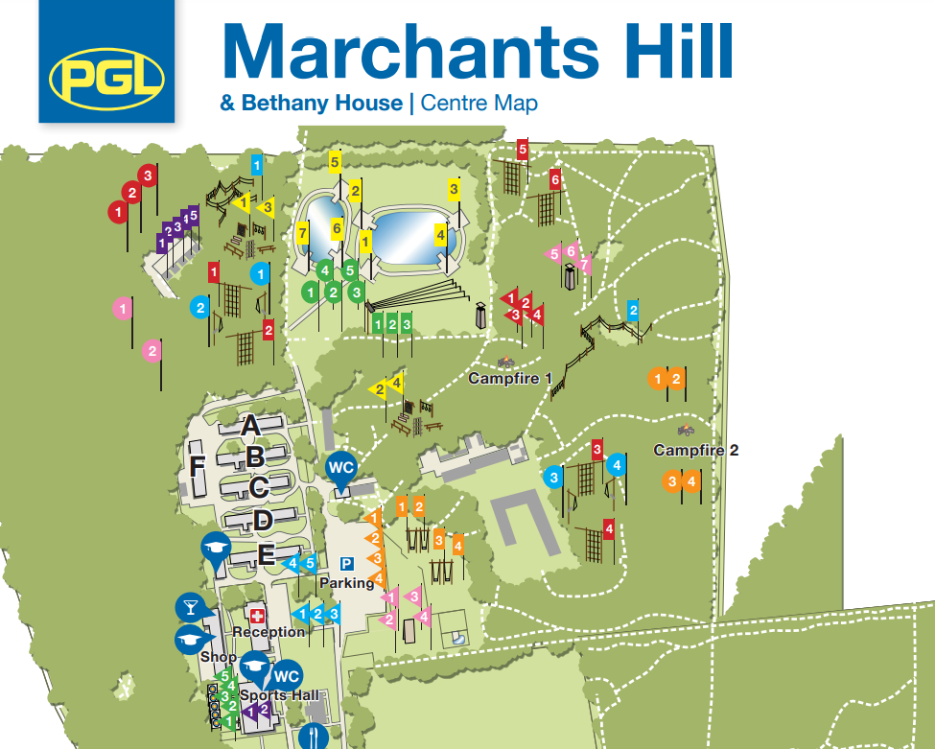
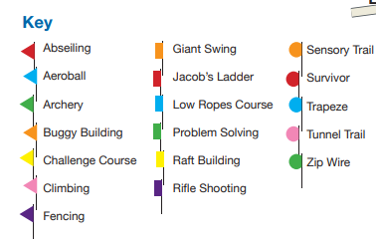
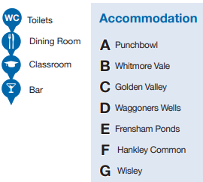
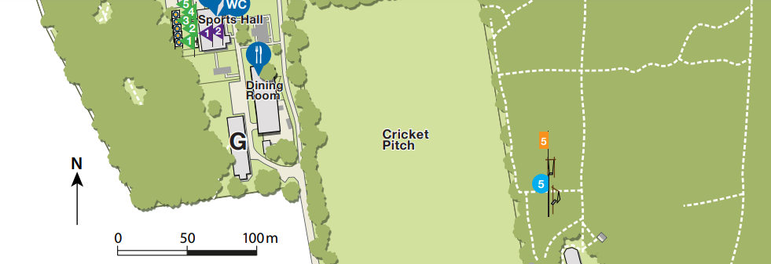
Where we’re going…
This is our block!

Slide 5
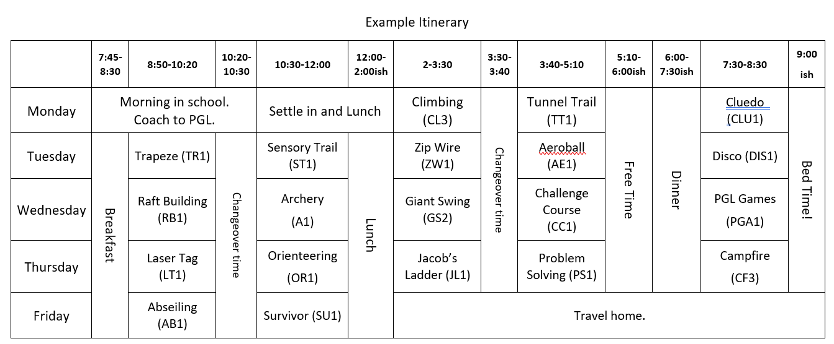
Monday and Friday Logistics

Slide 6
Monday and Friday Logistics
On Monday, morning children should be dropped off at the Main Hall with their bags and bedding. This is from 8:30am-8:55am (normal drop off time).
Any medication to be handed into the child’s class teacher.
We should be leaving PGL at 2pm on Friday and hope to be back in school for the end of the school day.
Children will be collected on the Friday from the Main Hall.

Slide 7
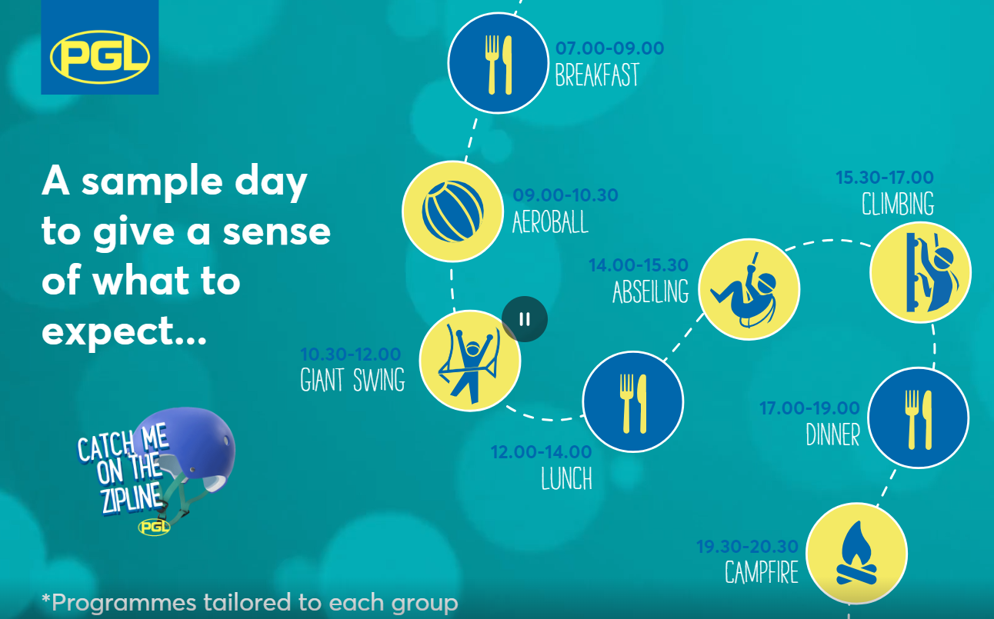
What does a typical day look like?

Slide 8
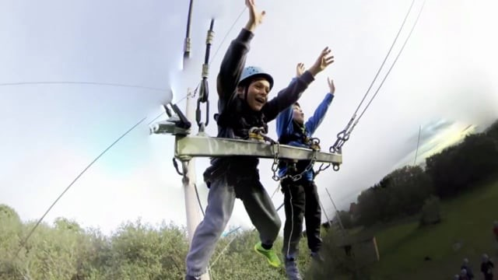
Experience a day at PGL- Timelapse

Slide 9







Our Activities
Evening Activities
PGL Tournament
Ambush
Campfire
Disco!
Aeroball
Tunnel Trail
Sensory Trail
Challenge Course
Laser Tag
Abseiling
Survivor
Orienteering
Trapeze

Slide 10
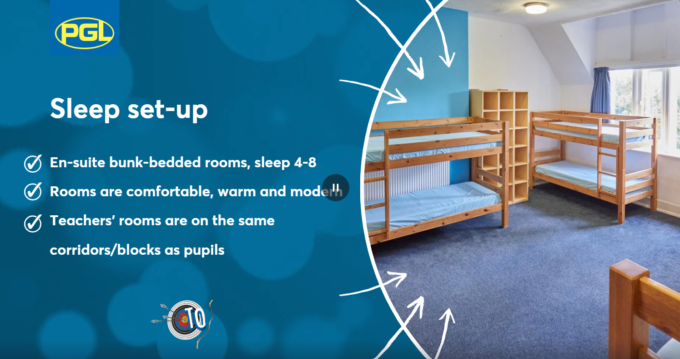
Adults rooms are spread out between pupil rooms.
We guarantee that you will have at least one friend in your room and day group.

Slide 11
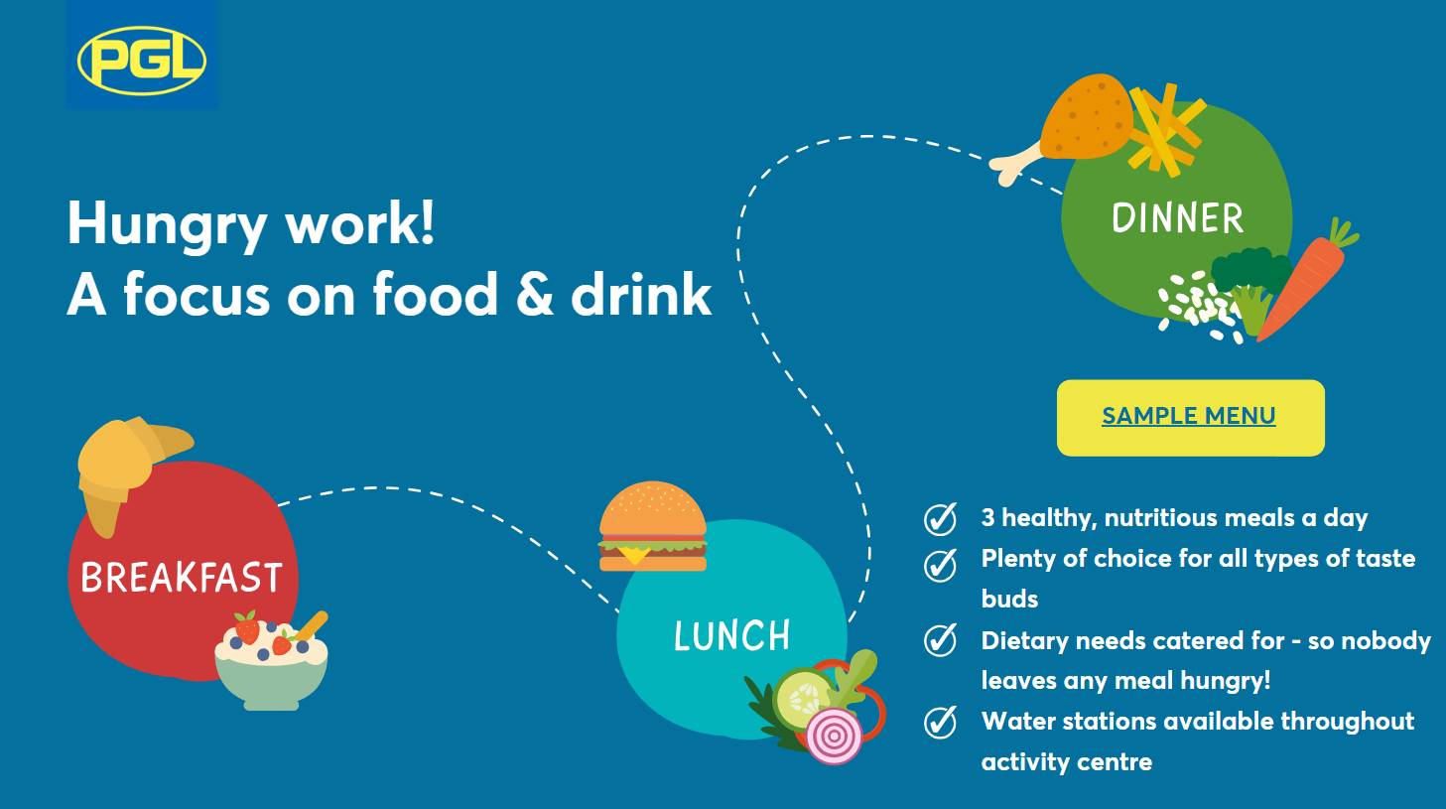

Slide 12
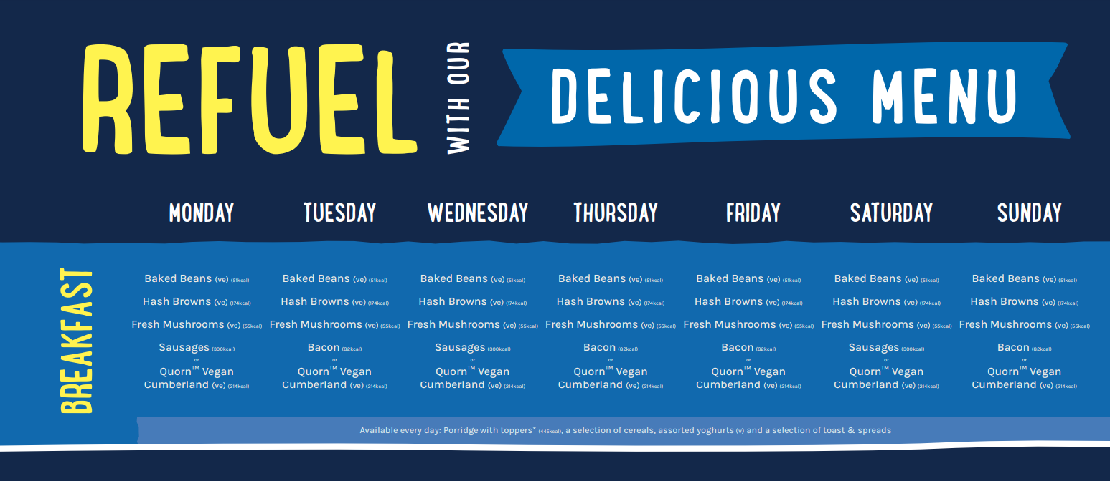
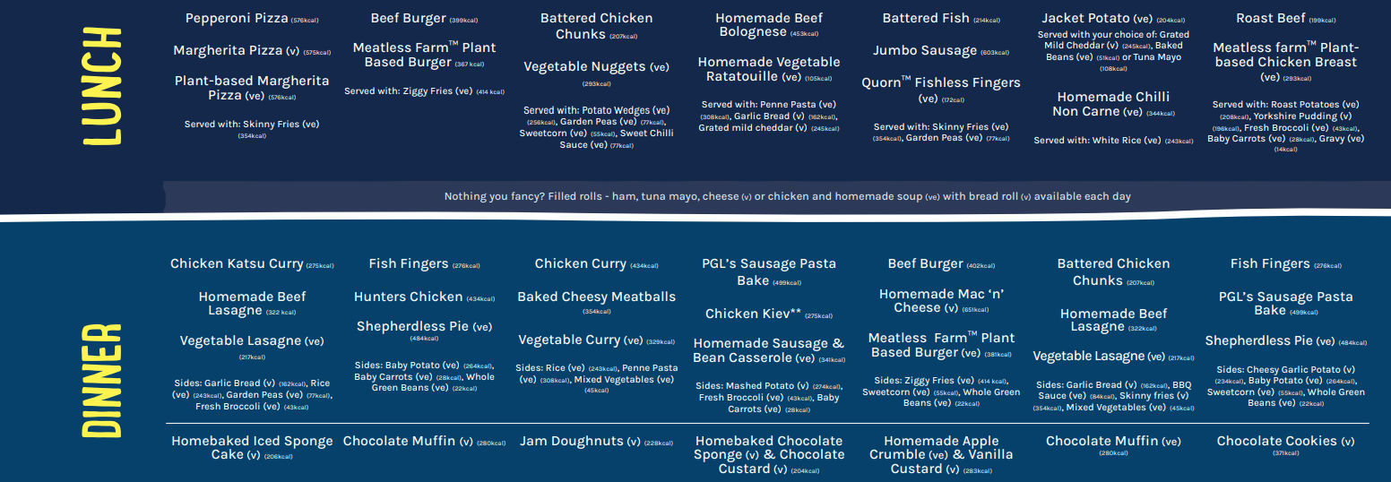
sample

Slide 13
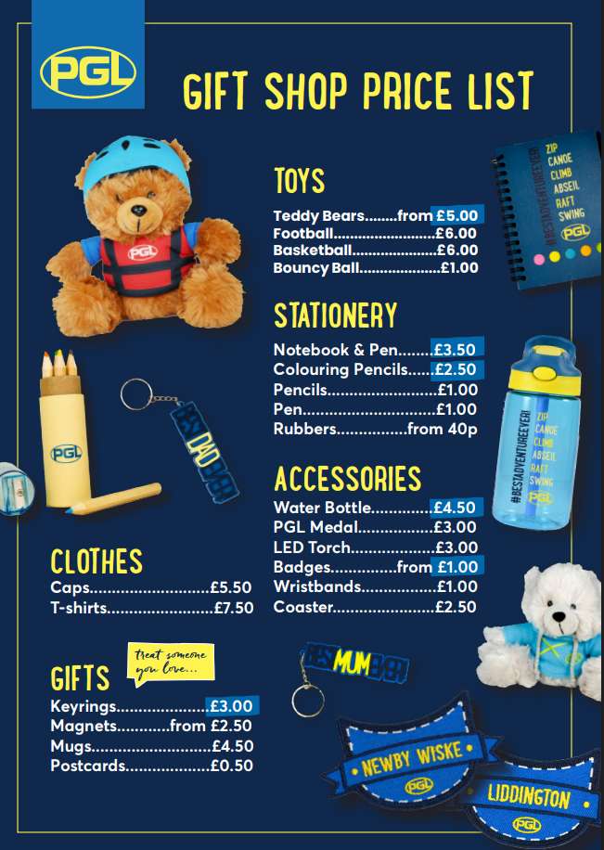
You are allowed to bring up to £6 pocket money

Slide 14
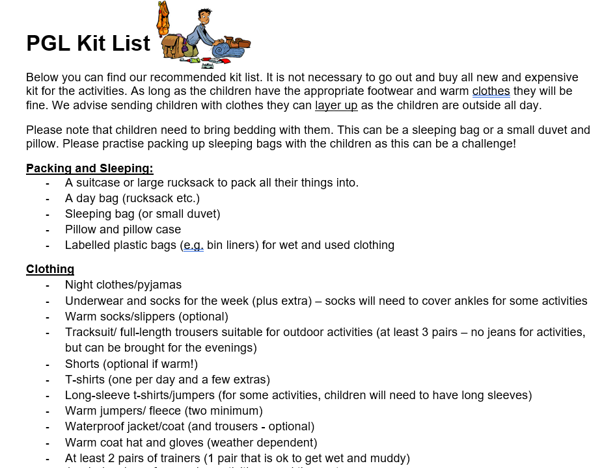
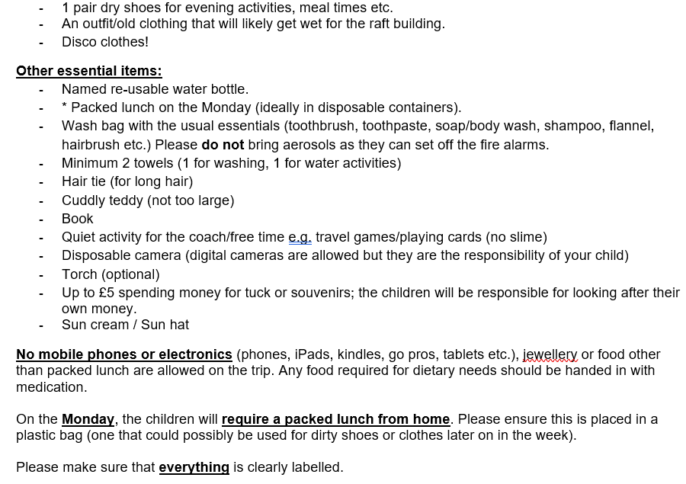
What to bring…

Slide 15
Medicines, sleeping and safety
Please hand all medication to your child’s class teacher. Miss Simpson will manage morning/evening medication. Day to day medication such as inhalers will be kept by group leaders.
In the dorms, the corridor lights are always on, but children may bring night-lights, teddies, torches etc.
Greville staff rooms are placed amongst the children’s rooms, there is always an adult available for the children: any time of the night
The accommodation is secure and lockable (we have the whole block to ourselves!), as is the site around the dormitories and cafeteria. Only PGL staff have the code to access the site.

Slide 16


